Slide 1
Crop Price Prediction using Ensemble Kalman Filter (EnKF) and ERA5 Weather Data
A Data Assimilation–Driven Approach for Agricultural Forecasting

Slide 2
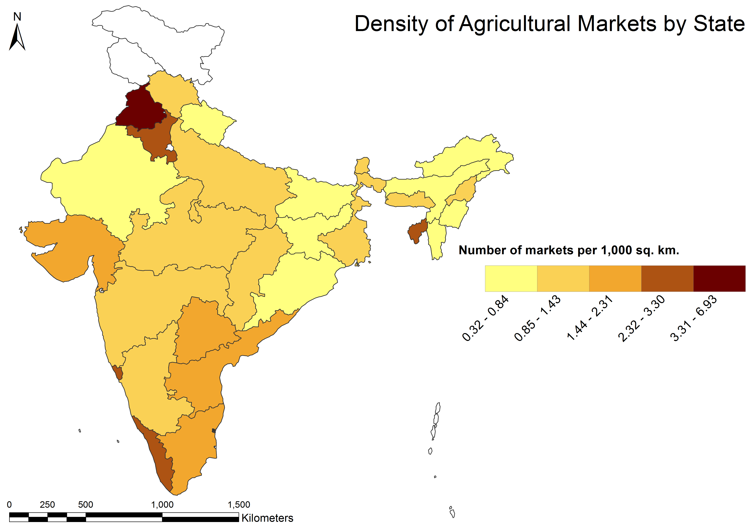
Why Crop Price Prediction Matters
Agricultural prices directly impact:
Farmer income stability
Food supply chains
Government procurement & MSP policies
Prices are highly volatile due to:
Weather uncertainty
Spatial market heterogeneity (mandis)
Missing and noisy data

Slide 3
Limitations of Existing Approaches
Time-series models (ARIMA, LSTM):
Poor uncertainty handling
Require long, clean histories
Pure ML models:
No physical interpretation
Overfit & collapse under regime change
Most work ignores data assimilation
Poor Handling of Missing and Irregular Data:
Real market data:
Missing days
Irregular Reporting
Sudden discontinuities
Heavy interpolation leads to bias
Most models perform poorly due to lack of good quality data
Mean Collapse in Sequential Models:
Sequential Filters (Kalman):
Collapse to the mean
Lose responsiveness over time
Market dynamics (policy, weather, supply) are abrupt
Over-smoothing destroys signal

Slide 4
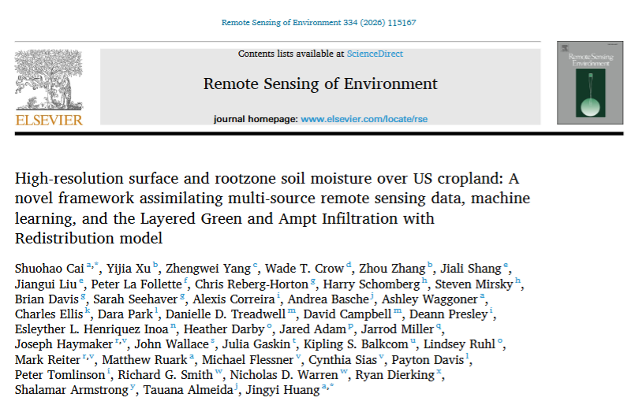
Research Inspiration (Literature)
Recent work (Remote Sensing of Environment, 2026) shows:
Ensemble Kalman Filter (EnKF) successfully integrates:
Process-based models
Machine learning predictions
ERA5 weather
Achieves robust, uncertainty-aware forecasts
Applied to soil moisture & crop systems
Positive results have also been achieved with CGNN per feature in some papers

Slide 5
Data Sources
1. Agricultural Market Data (AGMARKNET)
Daily mandi-level prices
Commodity-wise filtering
Interpolation for short gaps
2. Weather Data (ERA5)
Temperature (t2m)
Rainfall (tp)
Solar radiation (ssr)
Daily aggregation & normalization

Slide 6
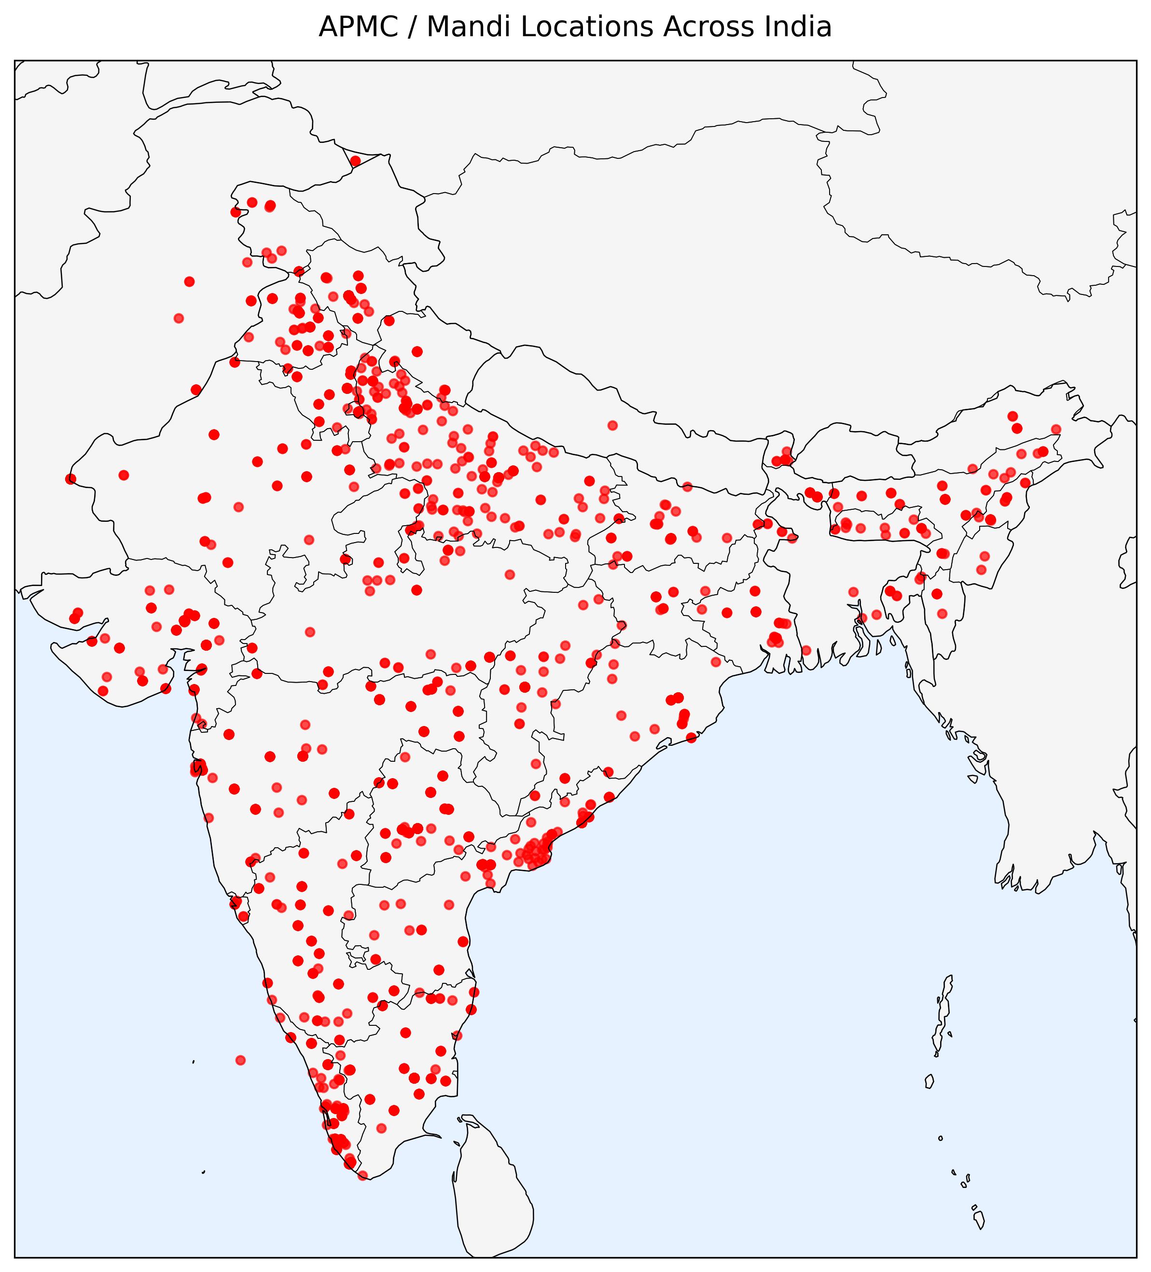
Proposed System
ERA5 Weather ───▶ System Dynamics
│
Past Prices ───▶ EnKF Forecast Step
│
Observed Prices ─▶ EnKF Update Step
│
Smoothed Price Forecast

Slide 7
Results Till now
Performance:
Multi-mandi price forecasting
Stable dynamics across time
RMSE computed on denormalized prices
However:
EnKF overcompensates and smooths the price prediction.

Slide 8
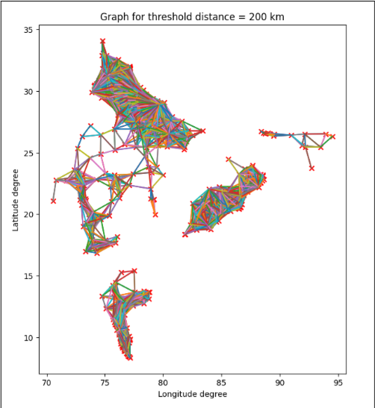
Further research
Decision Optimization on Top of Forecasts:
Use EnKF-based price forecasts as inputs to a decision-making layer rather than as final outputs.
Model mandis as economic nodes connected by transportation cost and logistics constraints.
Formulate crop selling as an optimization problem that solves:
Which crop to sell
At which mandi
At what time
In what quantity
Incorporate transport costs, storage limits, spoilage, and market arrival constraints into the objective function.

Slide 9
Applications
Industrial machinery monitoring: Estimating hidden component health from noisy vibration and temperature signals under varying operational loads.
Predictive maintenance systems: Tracking gradual degradation of machine parts while assimilating irregular sensor readings in real time.
Structural health monitoring: Inferring stress and fatigue evolution in bridges, aircraft, or turbines driven by environmental and usage variations.
Power grid stability analysis: Modeling substations as interacting nodes affected by demand fluctuations and external disturbances.
.
Transportation networks: Tracking traffic node congestion under weather, demand surges, and inter-node propagation effects.
Sensor networks: Fusing incomplete and noisy measurements from distributed nodes exposed to environmental drift.

